Slide 1

CSS Class vs. ID Selectors
by Mary Oldroyd
Notes:
My name is Mary Oldroyd. I chose CSS Class vs. ID Selectors - which one should I use? Let's start by looking how each one works

Slide 2

What is Class Selector and how it is used
Notes:
. In the next example, I have created a class called logo and a class called “logo large” and have applied it to several places in my document. Each of the elements that have the class applied are highlighted.

Slide 3

Class Selector
class
The case-sensitive class selector starts with a dot (.) character. It will select everything in the document with that class applied to it
Note: A class name cannot start with a number!
Example: One-word class Two-word class
HTML code HTML code
<h2 class="logo">Kratos </h2> <h2 class=“logo large">Kratos</h2>
CSS Class CSS Class
.logo { .logo {
color: blue;} color: blue; }
Results Kratos .large{
font-weight: bold;}
Results Kratos
Notes:
Each time HTML class references “logo” it’s associated font is indexed blue. Multiple HTML class calls can be written for further customizations. For example, we can call logo and large which will color font blue and bold it. When changes are made to CSS classes it will impact all references to that class. This means that it will inherit styles from both classes, allowing you to apply styles that are defined in each class.

Slide 4

Classes Are Not Unique
Classes are commonly used for styling and applying similar styles to multiple elements
You can use multiple classes on the same element.
Notes:
In practice, classes are much more flexible and suitable for styling multiple elements. Classes allow you to apply the same styles to multiple elements without the constraint of uniqueness. Additionally, classes can be reused across different elements, making them more versatile.

Slide 5

What is Class Selector ID and how it is used
Notes:
Any styling information that needs to be applied to multiple objects on a page should be done with a class. The advantage of using an id selector is that it uniquely identifies a single element within the HTML document. This makes it ideal for applying styles or JavaScript functionality to a specific element. However, remember that IDs must be unique, so they cannot be reused for multiple elements within the same document.

Slide 6

Class Selector ID
id
The case-sensitive ID selector begins with a # rather than a dot character but is used in the same way as a class selector. However, an ID can be used only once per page, and elements can only have a single id value applied to them. It can select an element that has the id set on it, and you can precede the ID with a type selector to only target the element if both the element and ID match.
Example:
Notes:
Each element can have only one ID
Each page can have only one element with that ID
I have heard over and over that you should only use ID’s once, but you can use classes over and over. It sounded more like a good “rule of thumb” to me rather than something extremely important. It may seem to you that they don’t do anything different or that they can be interchangeable that is not the case ID’s are UNIQUE, and your code will not pass validation if you use the same ID on more than one element. Validation should be important to all of us! We’ll go over more reasons for uniqueness as we go on.

Slide 7

ID’s ARE UNIQUE
Each element can have only one ID
Each page can have only one element with that ID
The id selector uses the id attribute of an HTML element to select a specific element.
The id of an element is unique within a page, so the id selector is used to select one unique element!
To select an element with a specific id, write a hash (#) character, followed by the id of the element
Notes:
Specificity:
IDs have higher specificity than classes. This means that if a style is applied using both an ID and a class, the style defined by the ID selector will take precedence.
Classes have lower specificity, so they are useful for applying general styles that can be overridden by more specific selectors.
The primary purpose of IDs is indeed to uniquely identify individual elements within a document. While it's technically possible to use the same ID for multiple elements, it goes against best practices and can lead to unpredictable behavior, especially with CSS and JavaScript.

Slide 8

Why Classes or Class Selector ID
Notes:
The advantage of using an id selector (#unique in this case) is that it uniquely identifies a single element within the HTML document. This makes it ideal for applying styles or JavaScript functionality to a specific element. However, remember that IDs must be unique, so they cannot be reused for multiple elements within the same document.

Slide 9

Usage:
Classes can be applied to multiple HTML elements, while IDs are unique and can only be applied to a single HTML element within a page.
Classes are commonly used for styling and applying similar styles to multiple elements, while IDs are often used for uniquely identifying specific elements for JavaScript interactions or styling.
Specificity:
IDs have higher specificity than classes. This means that if a style is applied using both an ID and a class, the style defined by the ID selector will take precedence.
Classes have lower specificity, so they are useful for applying general styles that can be overridden by more specific selectors.
Syntax:
Classes are denoted with a dot (.) followed by the class name (e.g., .my-class), while IDs are denoted with a hash (#) followed by the ID name (e.g., #my-id).
Usage in CSS:
In summary, classes are more versatile and can be applied to multiple elements, while IDs are unique and used for identifying specific elements. IDs have higher specificity and are often used for targeting specific elements for styling or JavaScript interactions.
Notes:
Regarding CSS, there is nothing you can do with an ID that you can’t do with a Class and vise versa. I remember when I was first learning CSS and I was having a problem, sometimes I would try and troubleshoot by switching around these values. Nope. CSS doesn’t care. But we have to remember ID’s have a higher specificity than classes.

Slide 10

There are no browser defaults for any ID or Class
Adding a class name or ID to an element does nothing to that element by default.
Classes and ID’s don’t have any styling information to them all by themselves. They require CSS to target them and apply styling.
Note: An id name cannot start with a number!
https://codepen.io/mariaoldroyd/pen/XWwJqYr
Notes:
Let’s look at the examples

Slide 11
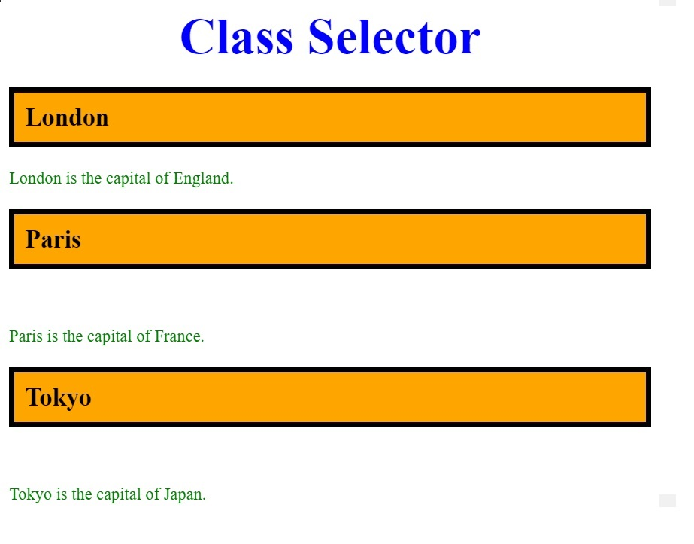

HTML
<header>Class Selector</header>
<div>
<h2 class="city">London</h2>
<p>London is the capital of England.</p>
</div>
<div>
<h2 class="city">Paris</h2>
<p>Paris is the capital of France. </p>
</div>
<div>
<h2 class="city">Tokyo</h2>
<p>Tokyo is the capital of Japan. </p>
</div>
CSS
.city {
background-color: orange;
color: black;
border: 5px solid black;
padding: 10px;
}
p {
color: green;
}
Notes:
On this example we see a class selector “city” this helps us style multiple elements within the page with a background color of orangeUsing classes in your HTML can save time when styling because they allow you to apply the same styles to multiple elements without repeating the style declarations. Instead of writing the same style rules for each individual element, you can define the styles once and apply the class to all the elements that need those styles.
For example, if you have multiple elements that you want to have the same font size, color, and background color, you can define a class with those styles and apply that class to each of those elements. This not only saves time but also makes your code more maintainable and easier to understand, especially if you need to make changes to the styles later on.

Slide 12
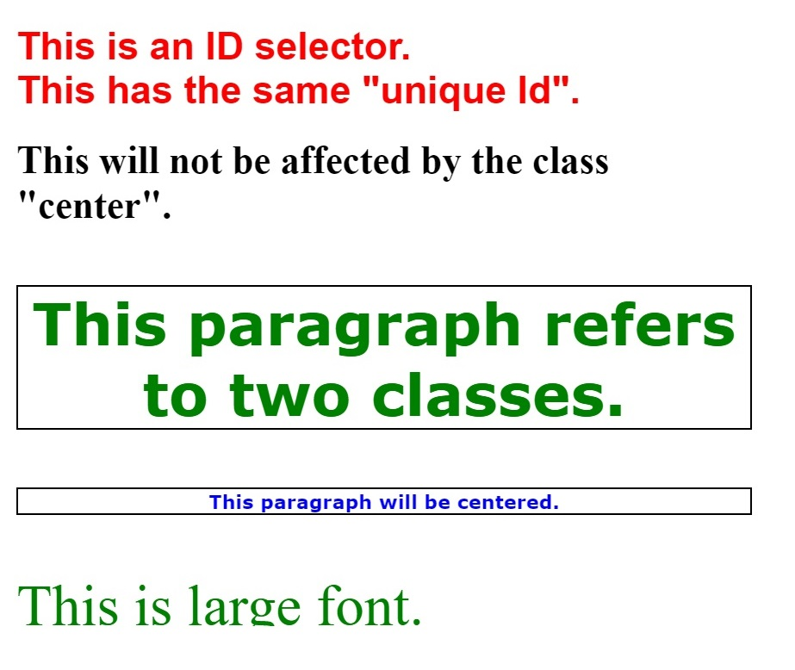

<div id="unique">This is an ID selector.</div>
<div id="unique">This has the same "unique Id".</div>
<h1 class="center"> This will not be affected by the class "center".</h1>
<p class="center large ">This paragraph refers to two classes.</p>
<p class="center"> This paragraph will be centered.</p>
<p class="large"> This is large font.</p>
CSS
#unique {
font-weight: bold;
color: red;
font-size: 2rem;
}
p.center{
font-weight: bold;
text-align: center;
color:blue;
border: solid black 2px;
}
p.large {
font-size: 3rem;
color: green; }
Notes:
The next example is an ID selector. As you can see, I used the same unique ID twice and when styling with CSS it styled both instead of just one. This is because it violates the HTML specification, because ID’s have to be unique within the document. If the ID is unique it will override all other styling rules for that particular element. I have an h1 element that has the same class selector “center” but it will not be affected because even though I am calling the class center it will only style the <p> elements. You can see that both <p> elements ae centered bold and have a solid border. But I wanted to the font color to be blue. The reason that it is green and not blue is that we used the class “large” to change the font to green along with the <p> element with a class of “large.“
Hope this helps everyone. Thank you

